Slide 1
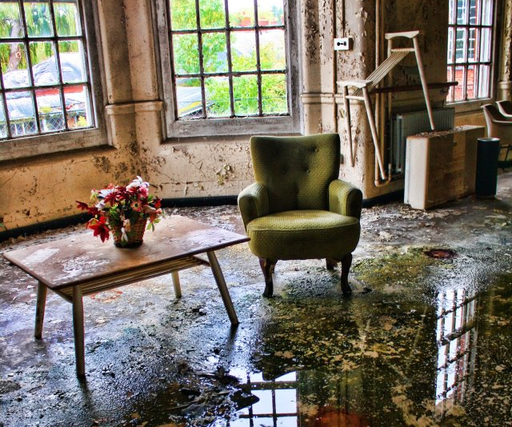
How I grabbed the “Non-Artistic” students
NAEA 2014, Greg Lawrence
Frank Gehry and the Trash Building:

Slide 2
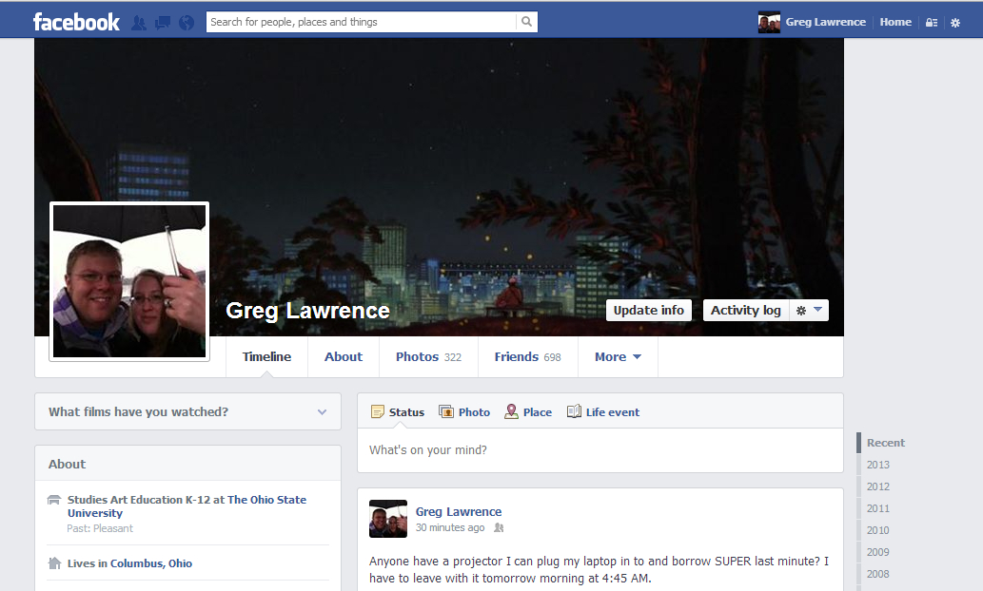

Slide 3
NAEA Presentation, March 2014
Unit Plan, Reclamation of the Abandoned
  Created for AE4200, Concepts in Planning Art Education
  Spring Semester 2013, OSU
Lesson 2, Frank Gehry and the Trash Building
  Abridged version taught to 8th grade Art Survey
  Indianola Informal School, 1 Class Period
  April 2013
Reflections and Criticisms
  How did I reach the “Non-Artistic” student?
  How do we reproduce the interactions?

Slide 4
A Unit in 5 Lessons by Greg Lawrence
Reclamation of the Abandoned

Slide 5
Abandonment & Reclamation
Exploring the effects of time on objects and reclaiming the abandoned for art.
Essential Questions & Concepts:
    What is Trash?
    What is Art?
    What is Beauty?
    Can something be beyond reclamation?
    Why do we make decisions as artists?

Slide 6
Abandonment & Reclamation
Exploring the effects of time on objects and reclaiming the abandoned for art.
Rationale:
The average student can relate well to the ideas of abandonment and reclamation. Especially in late middle school and early high school, students develop a “me vs. the world” mentality. They experience perceived abandonment in multiple social circles and communities. Often they feel that “no one understands” and that they are the only person to experience the troubles they are facing. The reuse of materials and reclamation of the abandoned can provide a positive reinforcement. In the “discarded” they can see themselves and see the rebirth into art.
Reclamation also has a great relation to the cultural significance of recycling and the environment. With the arrival of media outlets like Facebook and Pinterest, ideas of reuse and reclamation are invading the household and decoration. Always looking for a better, cheaper, and “greener” way of decorating our homes, reclaimed art is a cultural phenomenon.
The idea of the cyclical life of an object is also something we can relate to science as well as literary devices, giving the unit a good foothold for integration and deeper meaning.

Slide 7
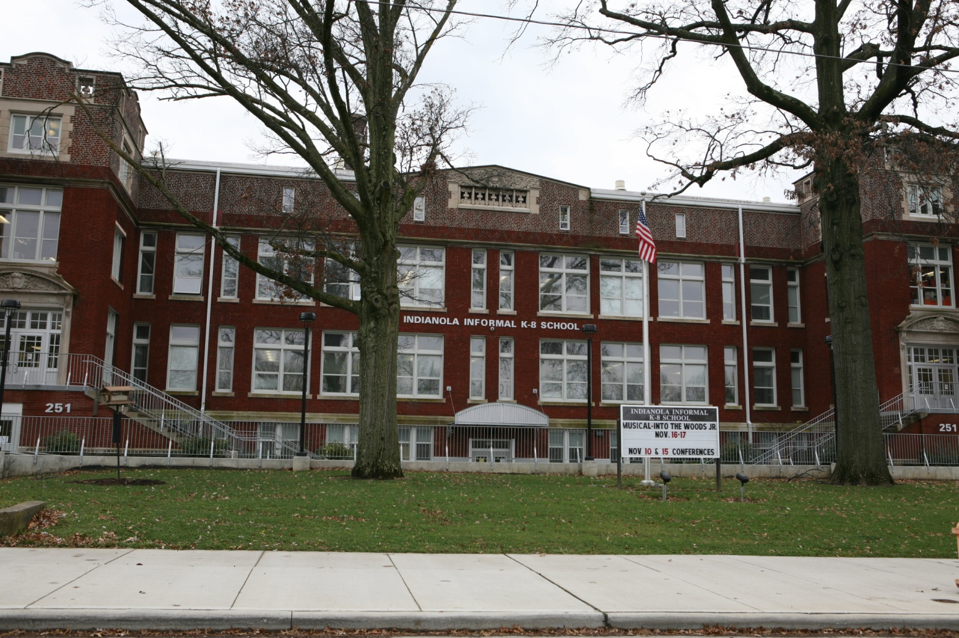
Indianola Informal K-8
Art Survey Course, 8th Grade
Columbus City Schools, 2 Classes, between 20-24 students a period, 55 minute periods
Unit Time Table: Jan 7th – March 28th 2013

Slide 8
Academic Content Standards
Visual Arts, Grade 8
Perceiving/Knowing
1PE: Identify how an artist’s choice of media relates to the ideas and images in the work.
4PE: Understand how social, cultural and political factors affect what contemporary
artists and designers create.
Producing/Performing
2PR: Demonstrate increased technical skill and craftsmanship by using more complex
processes and materials to design and create two- and three-dimensional
artworks.
4PR: Present personal artworks that show competence in the use of art elements to
create meanings and effects.
Responding/Reflecting
1RE: Examine various qualities in artworks to understand how an artist’s choice of media
relates to the images and ideas in the work.
2RE: Explain and defend their artistic decisions using visual art vocabulary.
4RE: Recognize how public discussion can affect beliefs about the nature and value of
art.

Slide 9
Lesson Zero:
Material Collection and Analysis
In the week leading up to and throughout the Unit, I will encourage the students to refrain from throwing anything into the trash can. We will collect a bin of material for use during the Unit. Anything and everything will go into the bin and we will attempt to keep it fairly organized despite its contents.
At the beginning of the Unit we will sort through the first week’s trash and divide it into 5 separate bins. The first bin will be labeled “Flat” and contain any and all trash that is thought of as flat. Examples would be scrap paper, cardboard, plastic sheeting, etc. The next bin will be labeled “Compost” and anything organic such as food waste or dirt will be stored in it. The “Beautiful” bin will be available for anything that is deemed beautiful. I expect this bin to be fairly empty at the beginning but might contain things like broken toys or colorful materials. The fourth bin will be labeled “Useful.” This would contain items that the class deemed useful and could include broken items that could be fixed or cardboard cups. The last bin will be labeled “Rubbish” and be the catch all bin for everything else. These items would be looked at as items that the class thinks are unusable or “gross.”
The separation and categorizing of trash will be infused with and then followed by a discussion on “What is trash?” and “How do you accommodate differing opinions?” Focus will be on understanding the different bins and what they can represent in art and the community as a whole. We will also discuss future lessons and how each of the bins might be used in the future. A reevaluation of the bins could follow the discussion resulting in some shuffling of trash.
At the end of the unit, the left over materials will be revisited and discussions will be focused on what was used, how things were used unexpectedly, and how anything leftover could still be used.

Slide 10
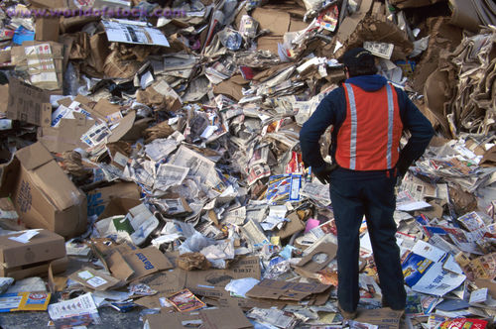
Lesson Zero:
Material Collection and Analysis

Slide 11
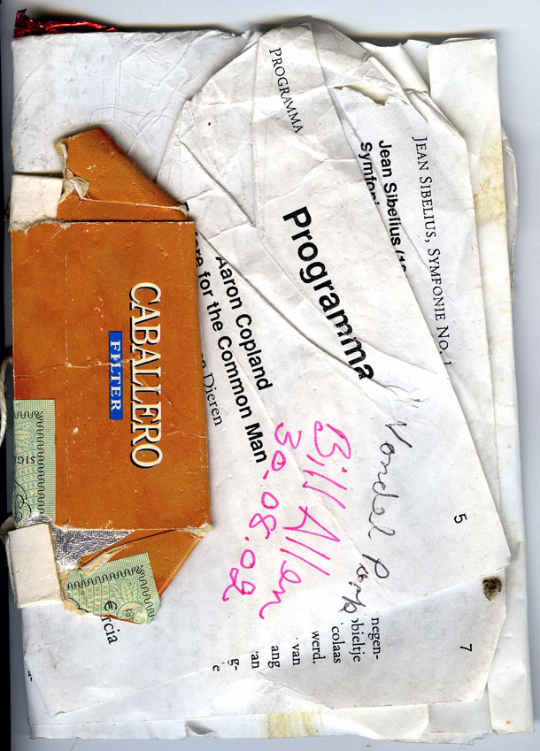
Lesson One:
Scrap Sketch Book
There will be a beginner lesson on book binding and the history of making books. We will stick to learning the simpler techniques but show examples of some of the more advanced techniques.
The class will be tasked with creating their own Sketch Books. Pulling materials from the Trash Bins we have set up, they will be creating books using techniques learned. Typically materials will be pulled from the “Flat” bin but I won’t limit the students if they want to create their book using materials from the other bins. Pages can be white washed to provide sketching space.
The sketch books created will be used as a place for notes, sketches, and assignments throughout the unit. A weekly drawing will be assigned as homework in the Sketch Books. The weekly drawing will be a part of the 30 day week drawing challenge. They will be collected and graded at the end of the semester with individual reviews throughout.

Slide 12
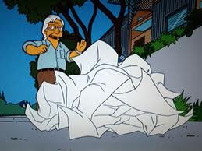
Lesson Two:
Frank Gehry and the Trash Building
The lesson will begin with a PowerPoint lesson and discussion on Frank Gehry, his techniques, and the ideas of plan, section, and perspective. Focus will be on the ideas of design and intent.
Students will then be presented with “trash buildings.” On each table of approximately 4 students, various sculptural pieces will be erected from materials in the various bins. Students will then be allowed to change, add to, and sculpt their pieces as a table unit. All changes must be accepted as a group however.
Using a premade template and their sketch books, the students will individually explore their “trash buildings” in plan, section, and perspective. They will be tasked with deciding the function, site, scale, and usability of their buildings. They will also take a digital photo of their building and manipulate it in Photoshop. The final product will consist of a photograph of their building, a digital interpretation of the building in use, a plan drawing, a section drawing, and a perspective drawing. A critique will be set up for the final and we will invite some local architects and architecture professors to sit in on it.

Slide 13
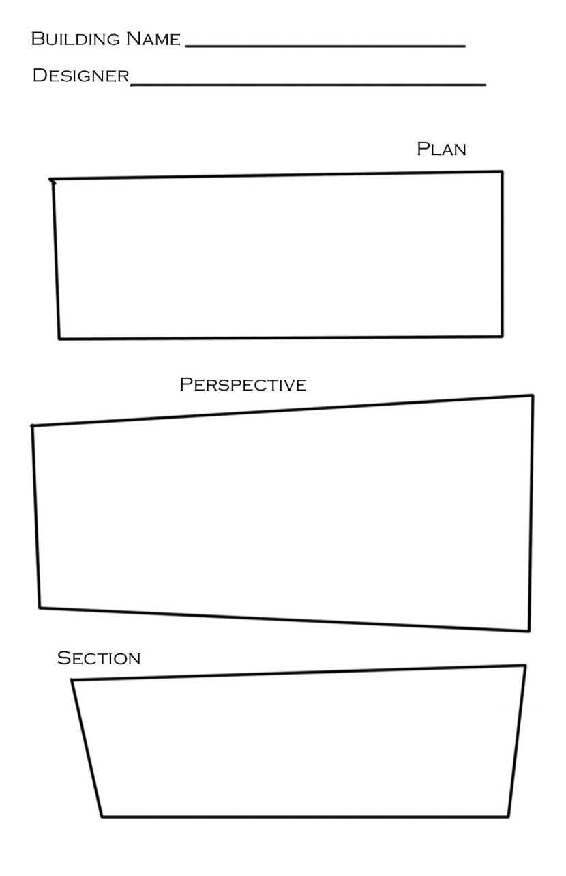
Lesson Two:
Frank Gehry and the Trash Building

Slide 14
Lesson Three:
Caddisflies and Beauty
This lesson will be integrated with 8th Grade Life Science: Topic – Species and Reproduction.
In this lesson, the students will work with the science teacher on topics about species and life cycles. As part of the lesson, the science students will go on site to a local stream bed to learn about life cycles and stages. They will each return, having caught between 2-4 caddisfly larvae. These larvae will be brought to the art classroom and placed in Tupperware containers for use in the art lesson. They will be observed over the course of the lesson through the lens of both a biologist and an artist.
Caddisfly larvae live in freshwater streams and case-making caddisflies may build cases exclusively of silk, but more commonly the silk holds together substrate materials such as small fragments of rock, sand, small pieces of twig or aquatic plants. These cases protect against predation as well as the harsh environment of the moving stream. French artist, Hubert Duprat removes these cases and provides the larvae with alternative materials to rebuild a case. These materials typically include gold flakes, opals, pearls, rubies, and other precious and semi-precious stones, creating small jewelry like sculptures that he refers to as collaborations. While the science lesson will cover the larvae stages, the art lesson will begin by recapping this information while introducing the work of Hubert Duprat.
Once the caddisfly larvae have been procured, their original casings removed, each student will select which materials they want to introduce into their own simulated streams. These simulated streams will be a Tupperware container per student. Students will observe the larvae through the rest of the unit and make observational notes and sketches in their Sketch Books.
The science lesson will conclude with the students releasing the larvae back into nature as they are ready to mature. The resulting leftover cocoon will be retained for the art classroom.

Slide 15
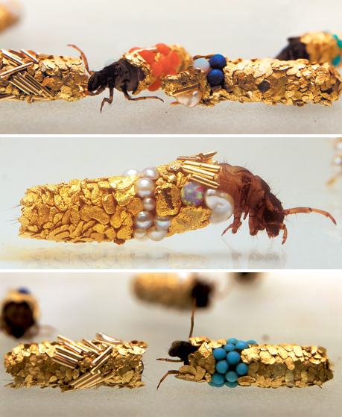
Lesson Three:
Caddisflies and Beauty

Slide 16
Lesson Four:
Graffiti and Appropriation
Lesson Four will begin with a discussion on Appropriation and the ethics of using something that you don’t own for your art. It will lead into a lesson on past and current graffiti artists, their reason, ideals, and methods. Special attention will go to works such as Shepard Fairey and his Hope poster and Banksy and his criticism of corporate labeling. The lesson and discussion will attempt to remain politically neutral but will focus on the students’ ideas rather than mine.
Stemming from ideas of reclamation and repurposing, we will view and discuss a series of photographs of abandoned places. These pictures will include photos of sites around the world that have been abandoned, some left to nature and others reclaimed by various graffiti artists. Topics of discussion will include ethics, art vs. vandalism, and the nature of beauty. We will also do a demonstration on creating and using a spray paint stencil.
Students will select topic of contention; this can be something discussed by the various graffiti artists or something that they feel passionate about. They will then design their own stencil based on their topic. These will be 2 or 3 color compositions and will ultimately be applied with spray chalk rather than spray paint.
Students will then select a site on the school grounds or in the community to apply their stencil. Abandoned or lesser used spaces will be encouraged. Spray chalk will be used to apply the artwork. Students will be responsible for any cleanup associated with their placement choice.

Slide 17
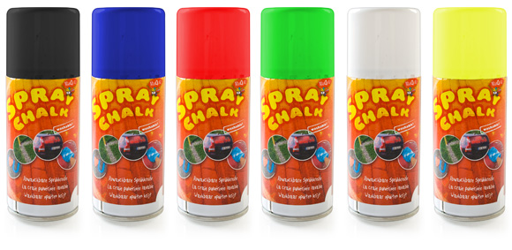
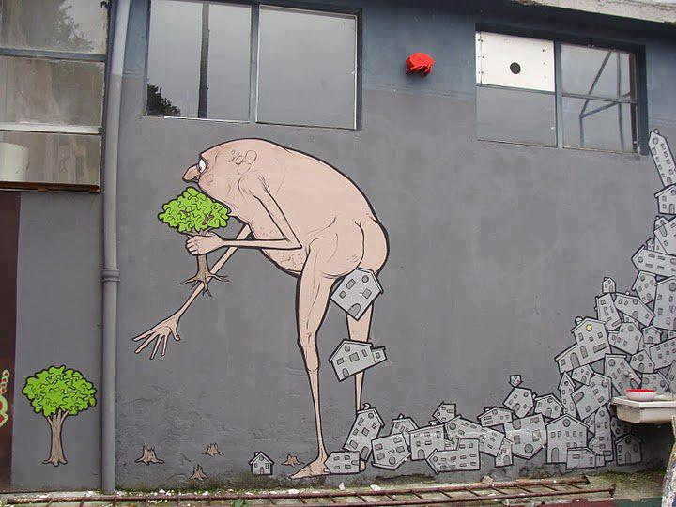
Lesson Four:
Graffiti and Appropriation

Slide 18
Lesson Four:
Graffiti and Appropriation
4 Tablespoons of Corn Starch
1 Cup Warm Water
4-6 drops of Food Coloring
1 Small Plant Mister
- Mix all ingredients in a medium bowl
- Pour the mixture into the plant mister
- Avoid clogging by shaking the mister before each use
- USE THE ENTIRE MIXTURE or dump the rest out and clean mister well

Slide 19
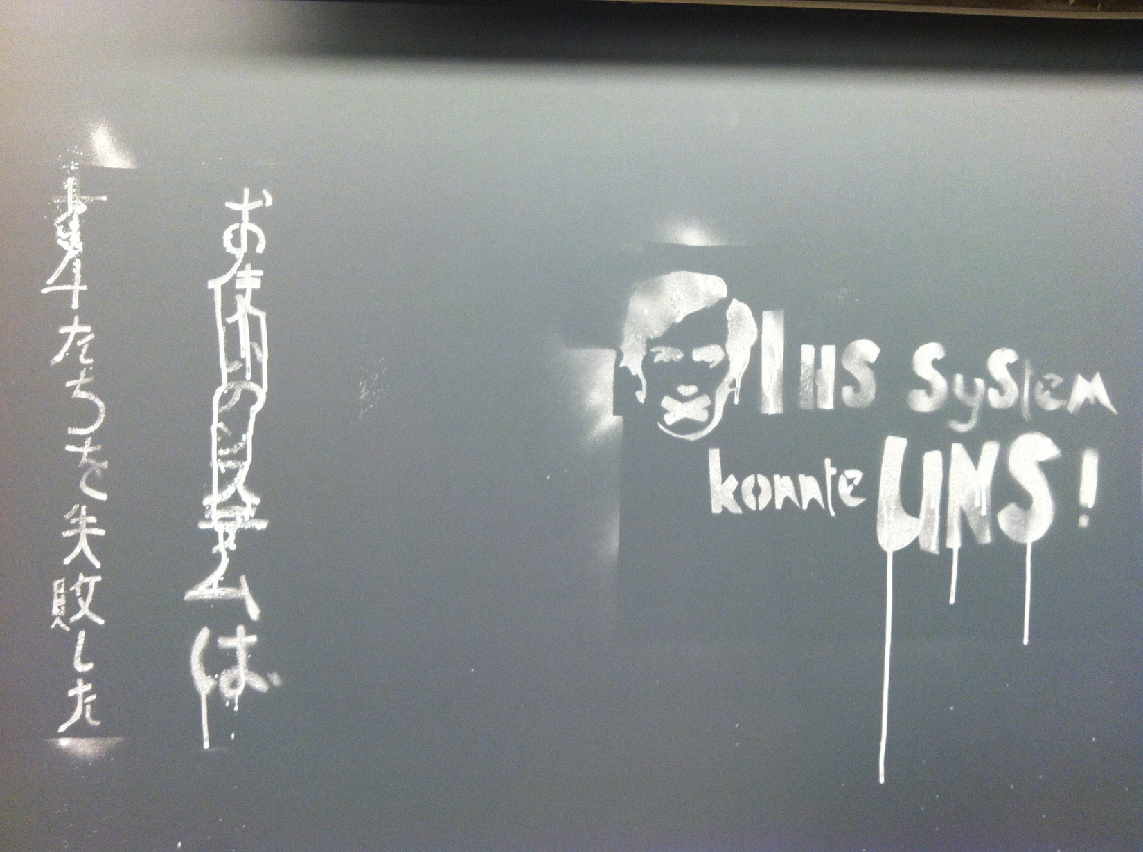
Lesson Four:
Graffiti and Appropriation

Slide 20
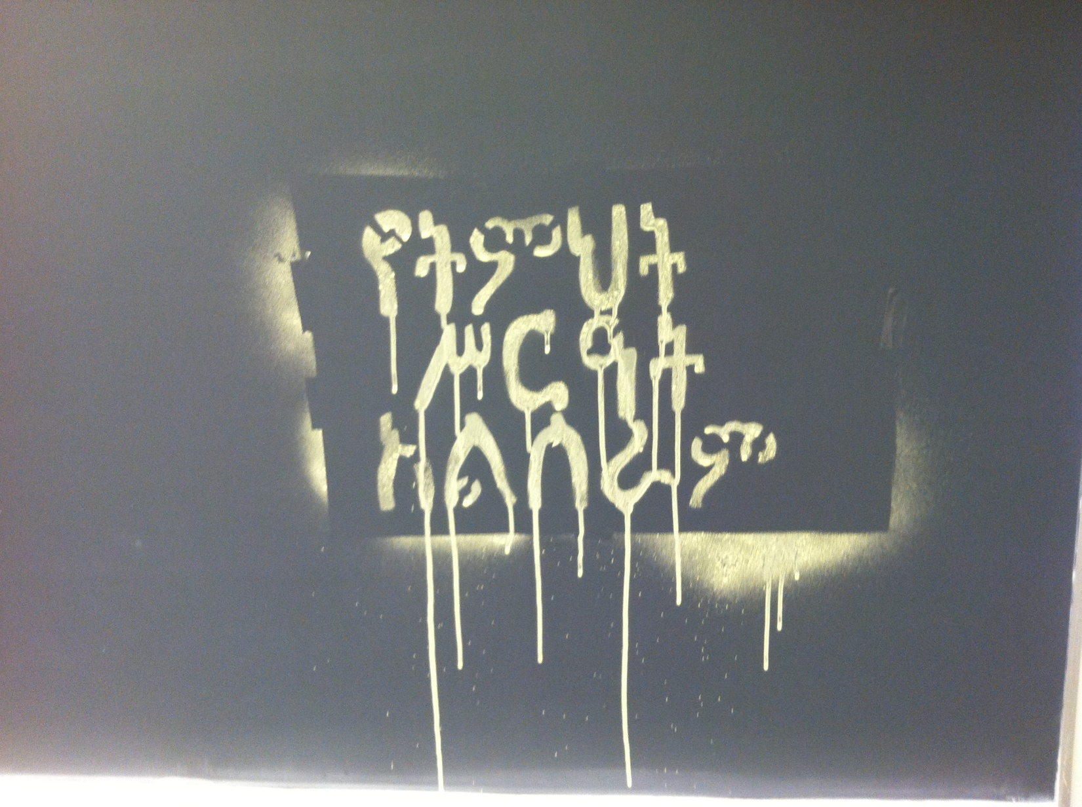
Lesson Four:
Graffiti and Appropriation

Slide 21
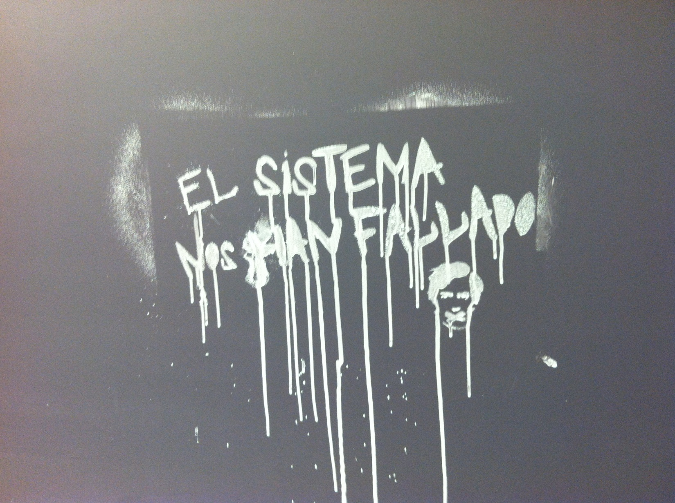
Lesson Four:
Graffiti and Appropriation

Slide 22
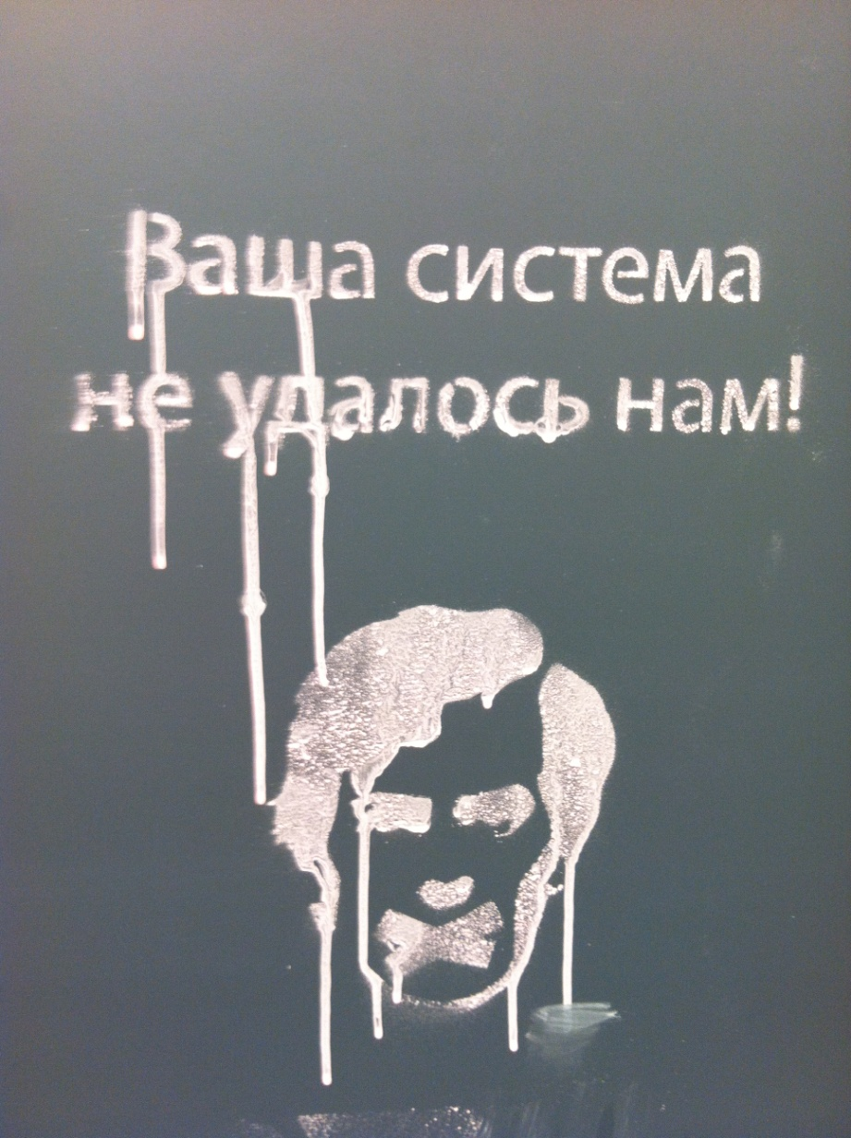
Lesson Four:
Graffiti and Appropriation

Slide 23
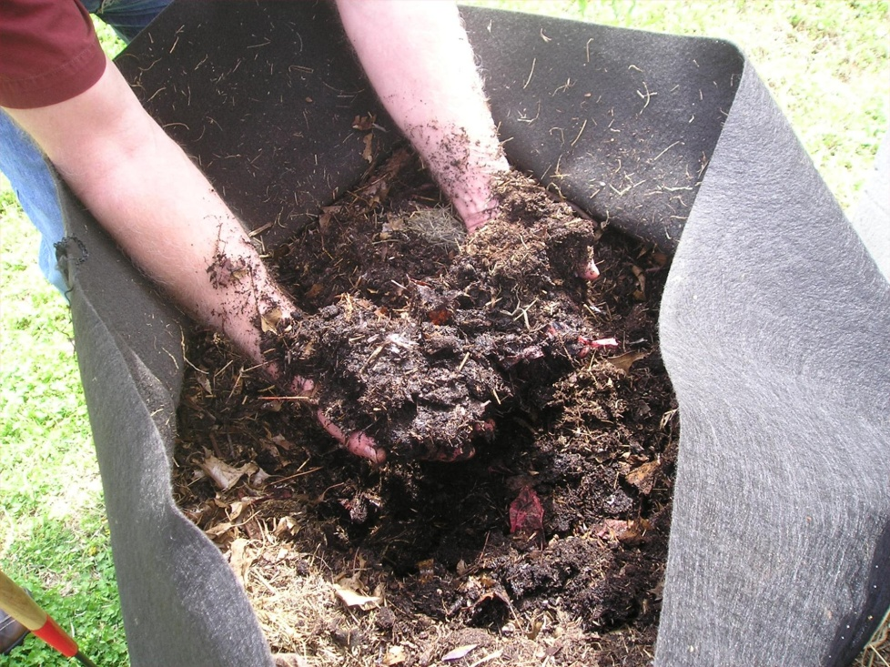
Lesson Five:
The Compost
Throughout the Unit, trash will be collected in the various bins listed in Lesson Zero. One of those bins is the “Compost” bin. While use of material that will be collected in this bin won’t be discouraged, typically this bin will go untouched. As a joint Science and Art lesson, this bin will form the basis of a compost pile that can be started at the school. As it is utilized in the classroom, changes will be monitored and discussed. Discussion of beauty will play a role in the life of the “Compost” bin.
As the unit concludes on the last day before Spring Break, the students will use the compost project and plant and fertilize flowers around the school. The flowers will be planted in various locations reflecting the type places that were chosen for Lesson Four.

Slide 24
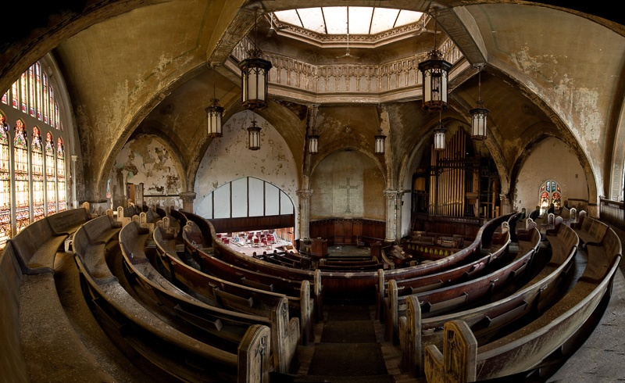

Slide 25
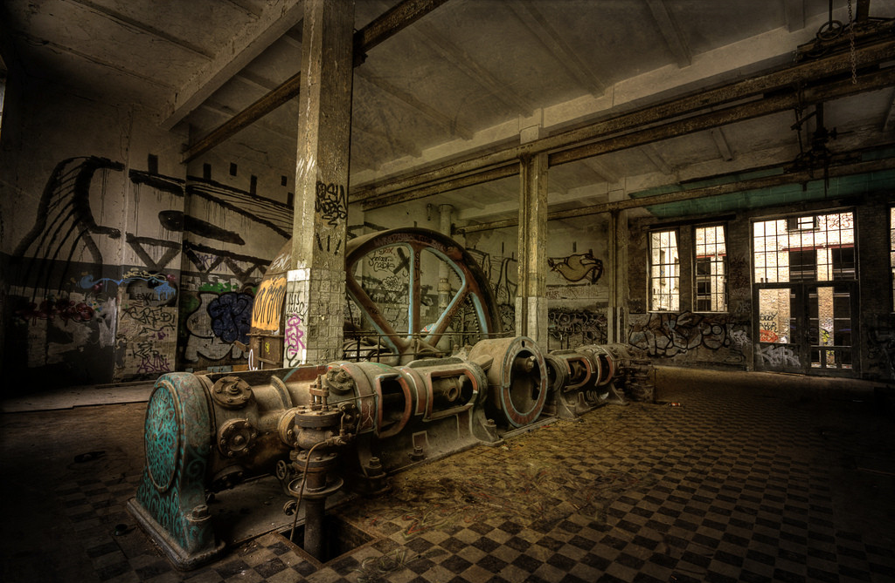

Slide 26
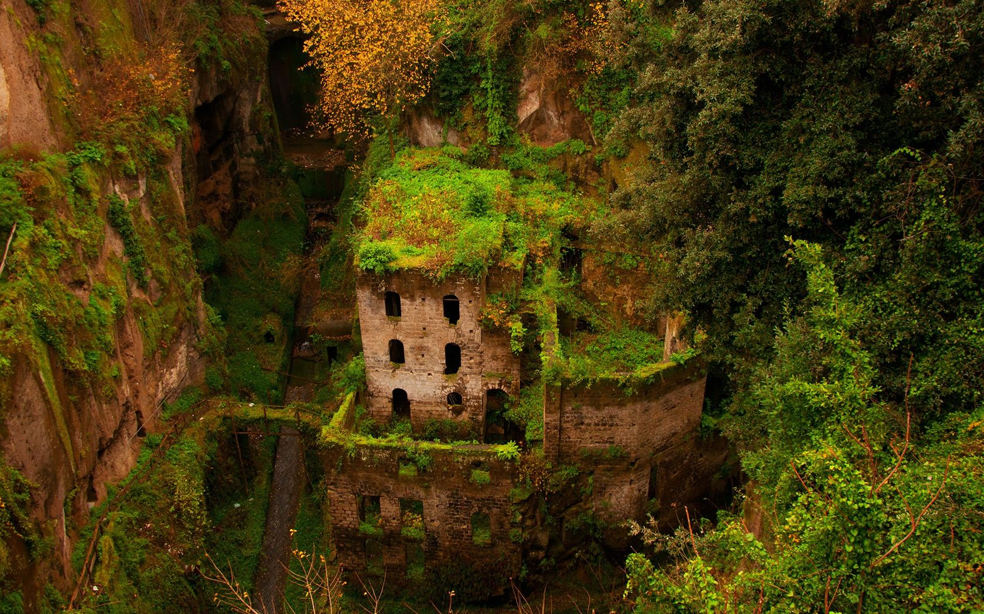

Slide 27
Frank Gehry

Slide 28
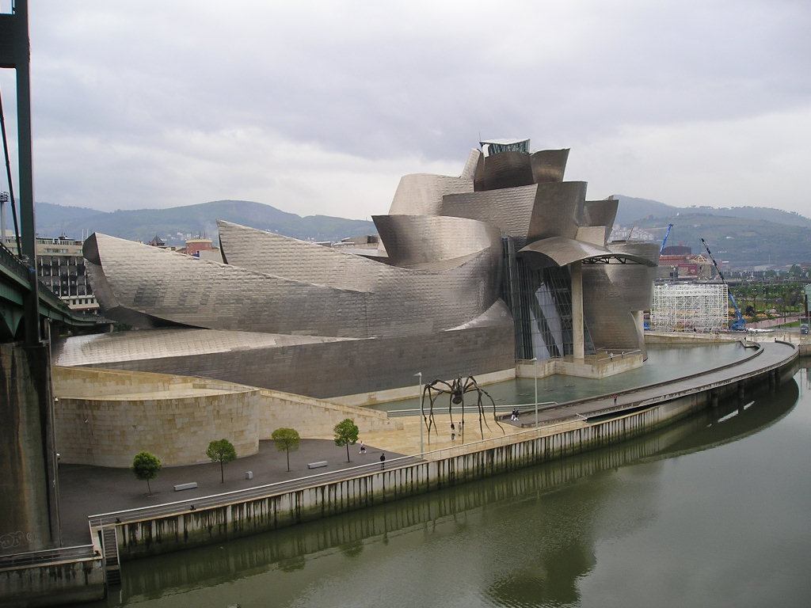

Slide 30
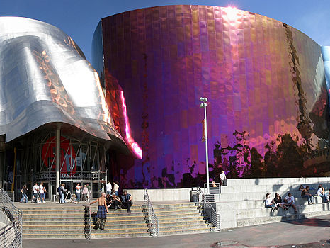

Slide 31
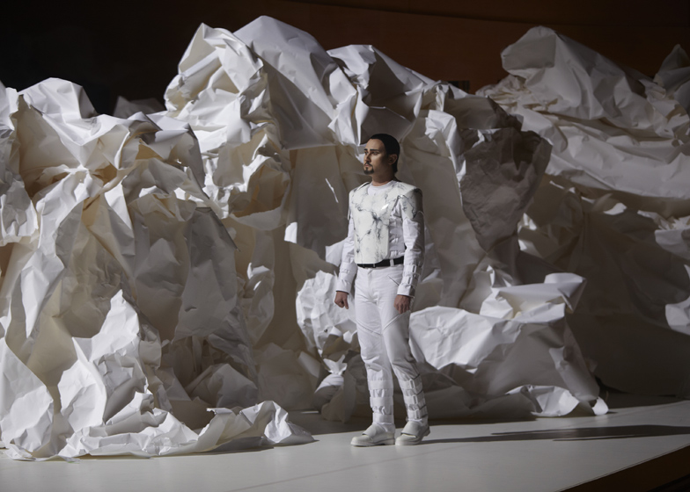

Slide 32
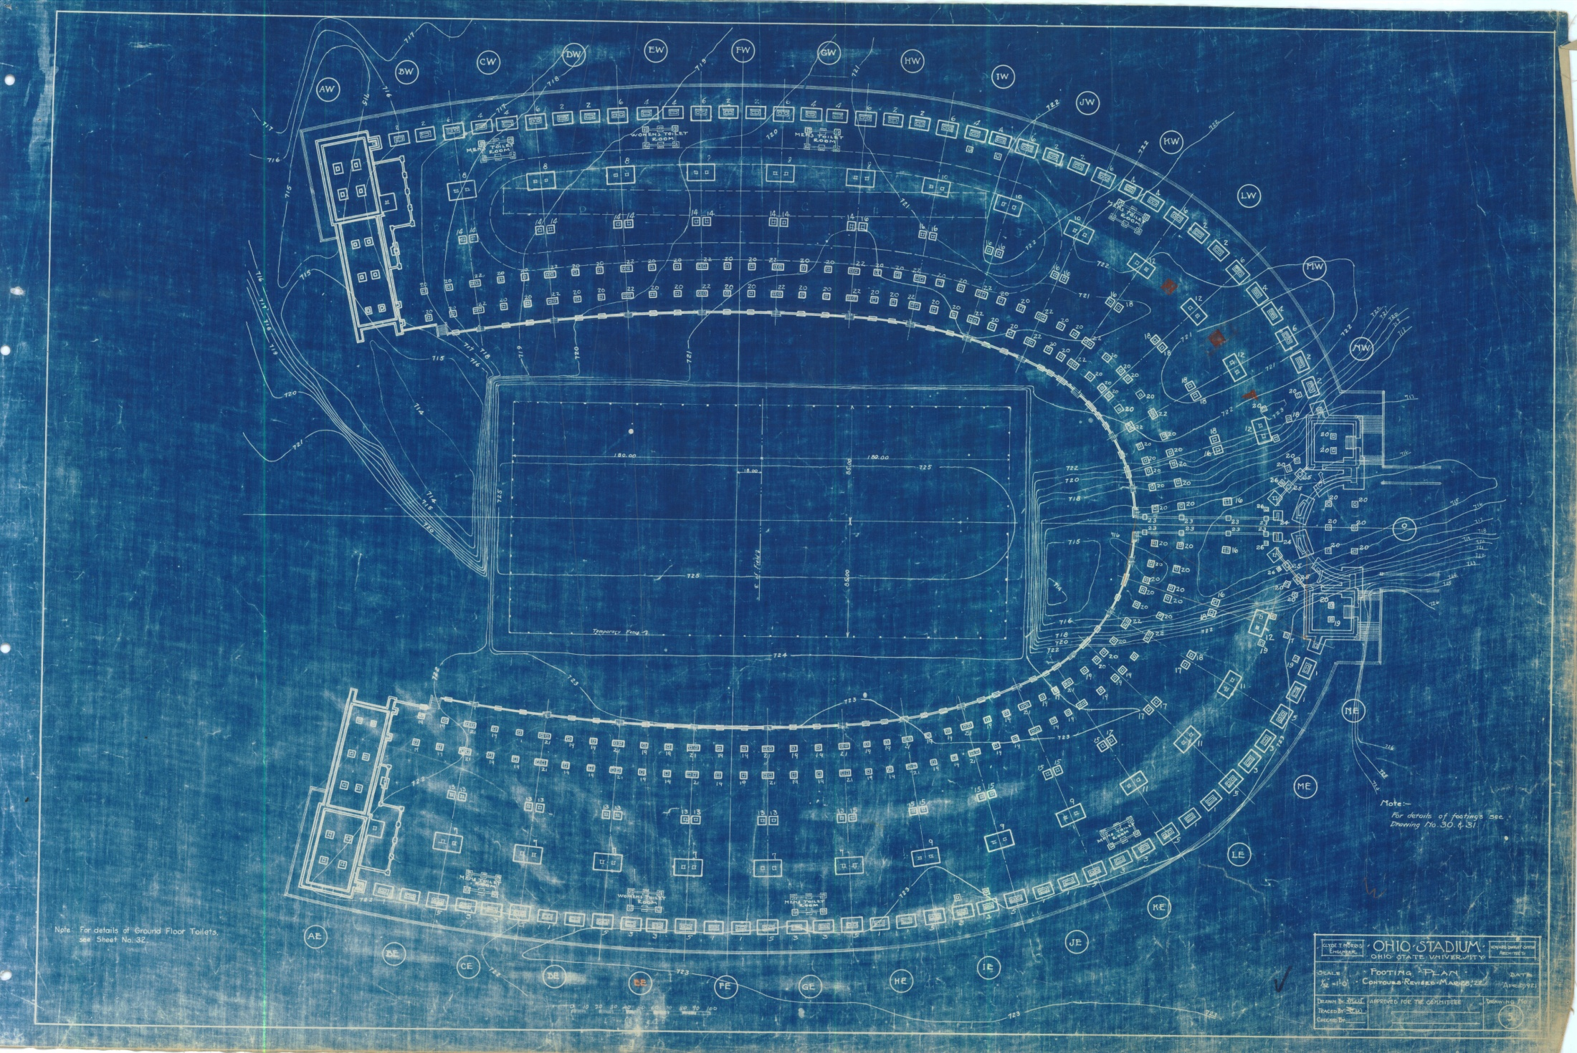

Slide 33
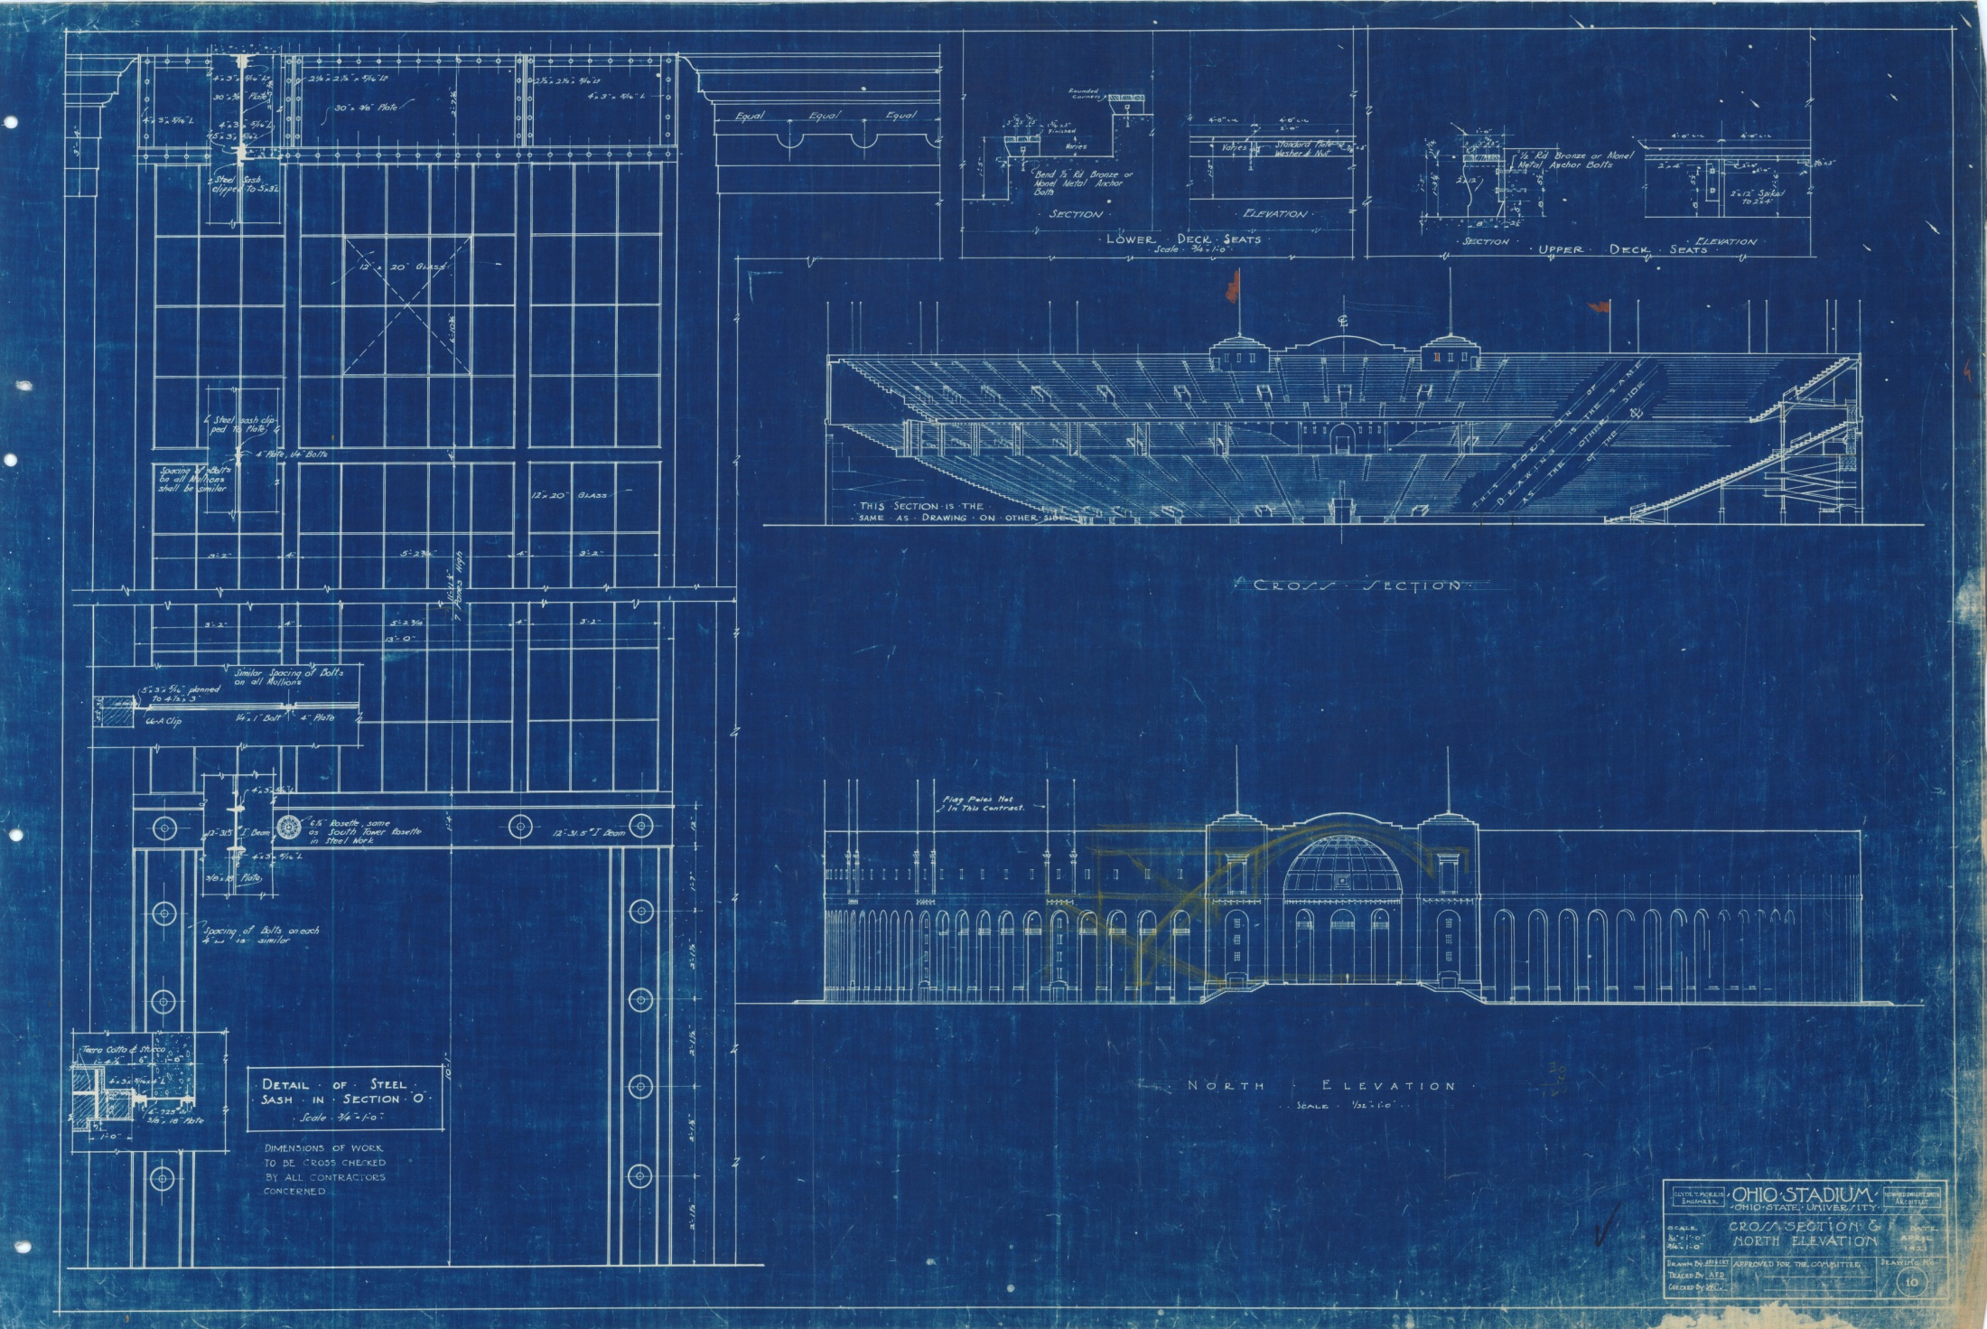

Slide 34
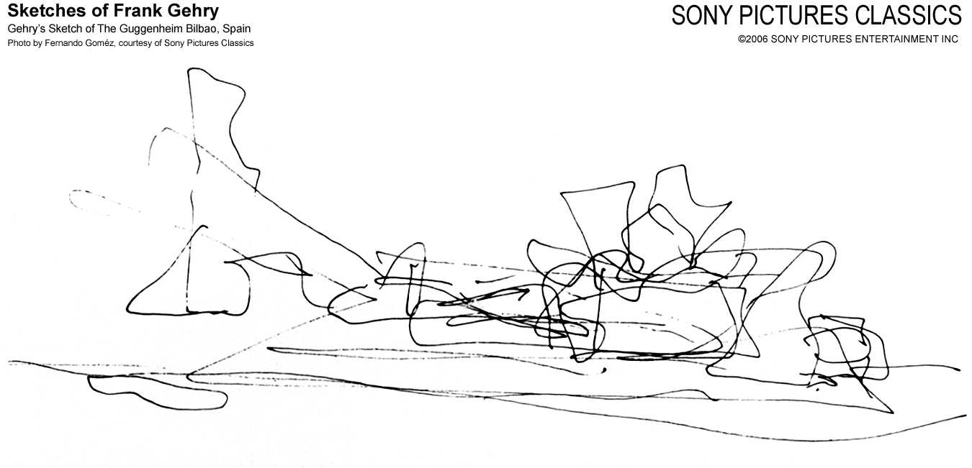

Slide 35
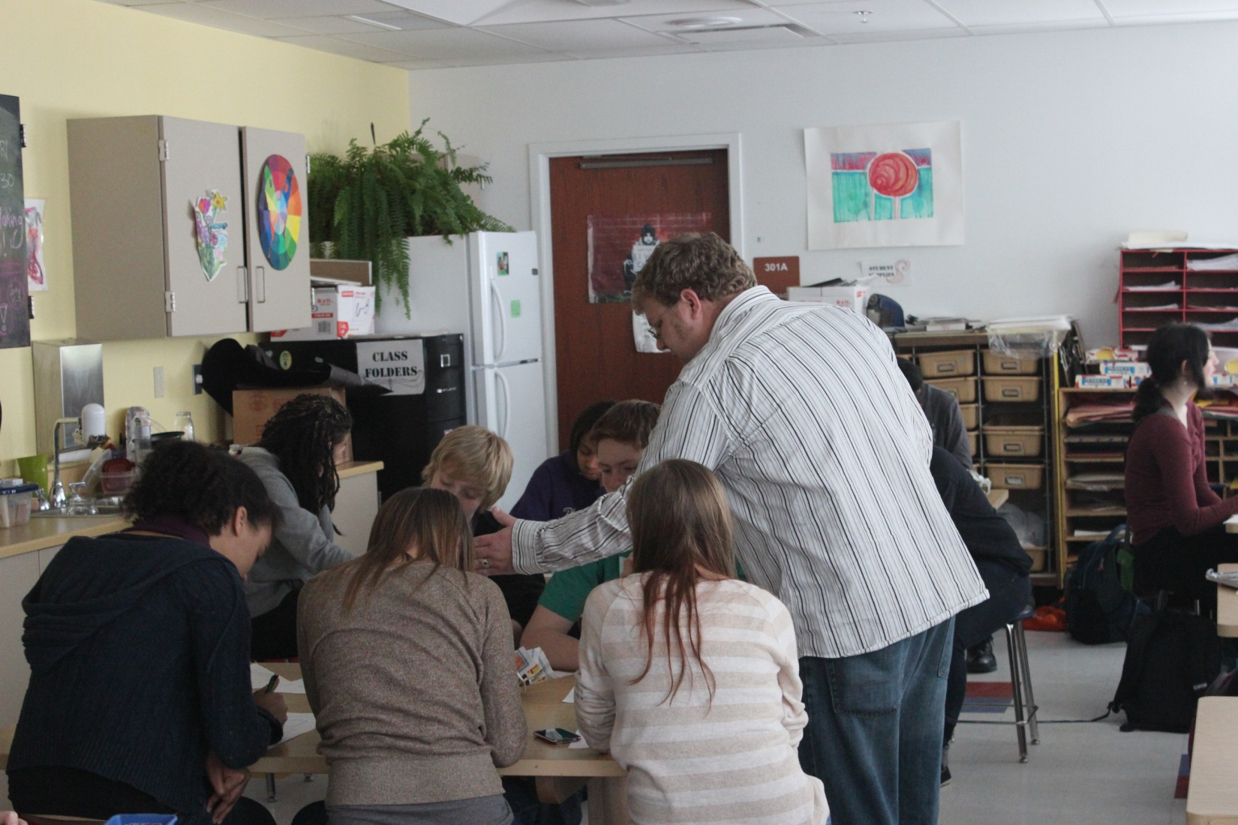

Slide 36


Slide 37
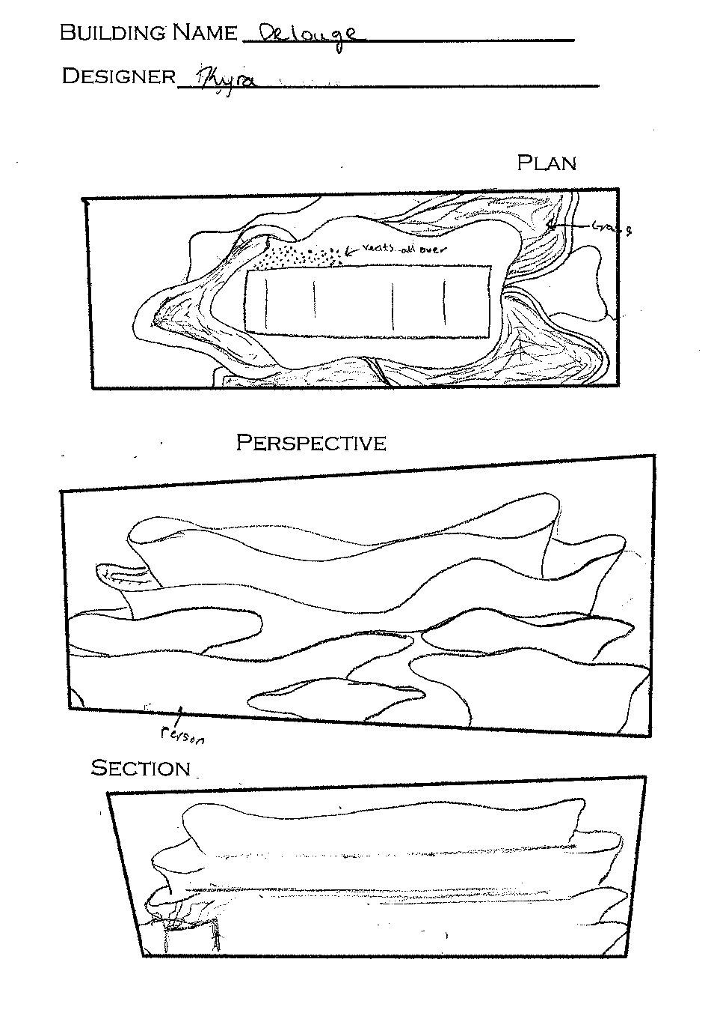

Slide 38
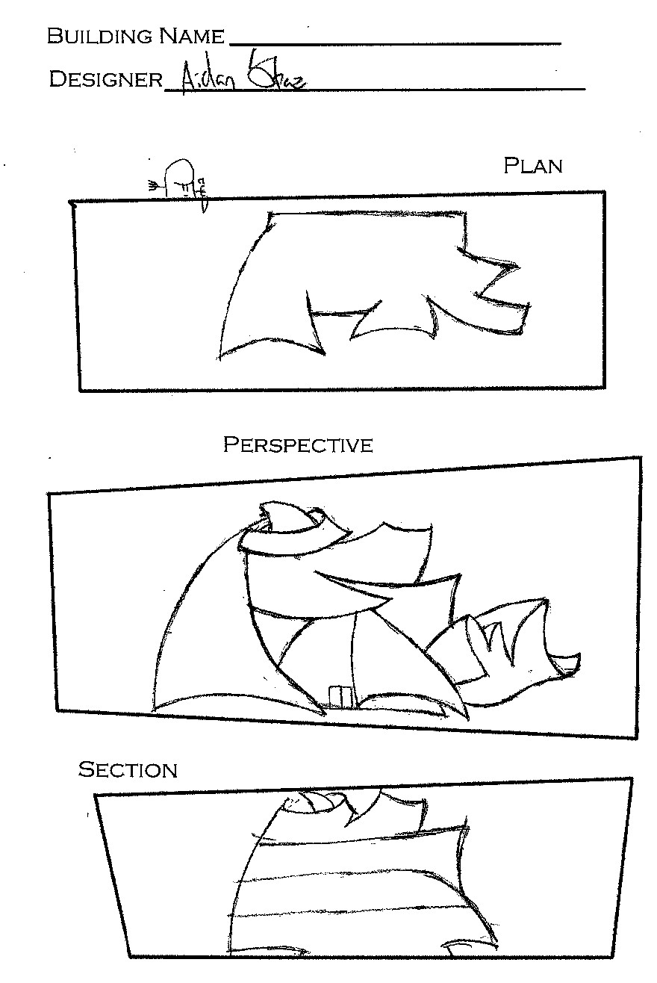

Slide 39
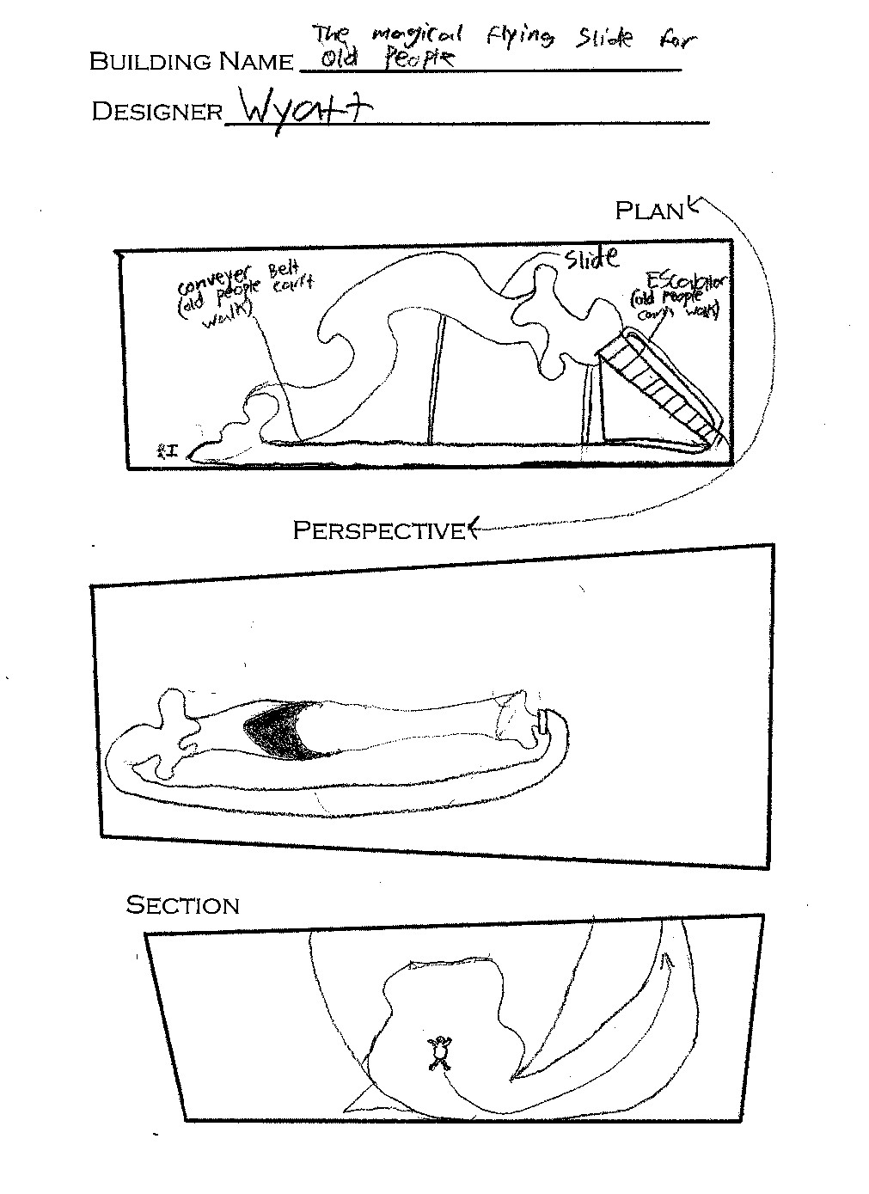

Slide 41
The “Non-Artistic” Students
Novelty
“Non-Art”
Design vs. Beauty
Imagination Focus

Slide 42
Questions?
Greg Lawrence
Ohio State University
Columbus, OH
lawrence.213@osu.edu

